Slide 1
Crash Bash
Created by :
Ali alaei sadegh tabasi ehsan mirabadi

Slide 2
Game in brief
-network architecture
-client duty
-server duty

Slide 3
Using git

Slide 4
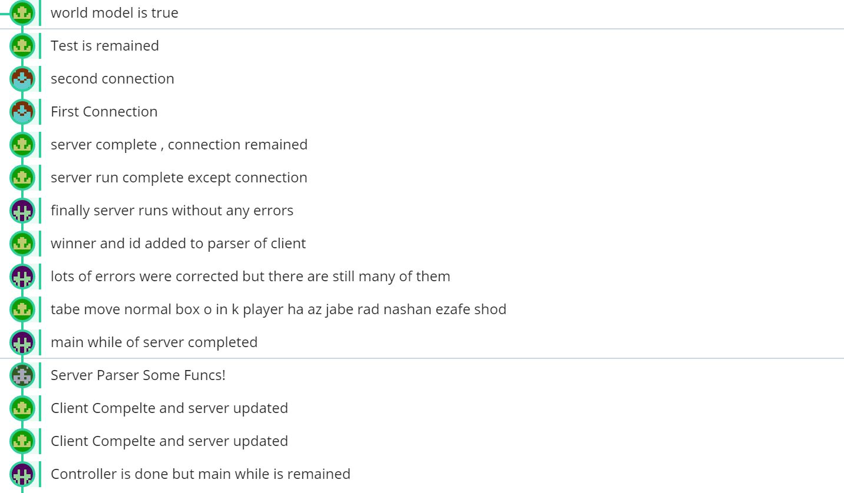
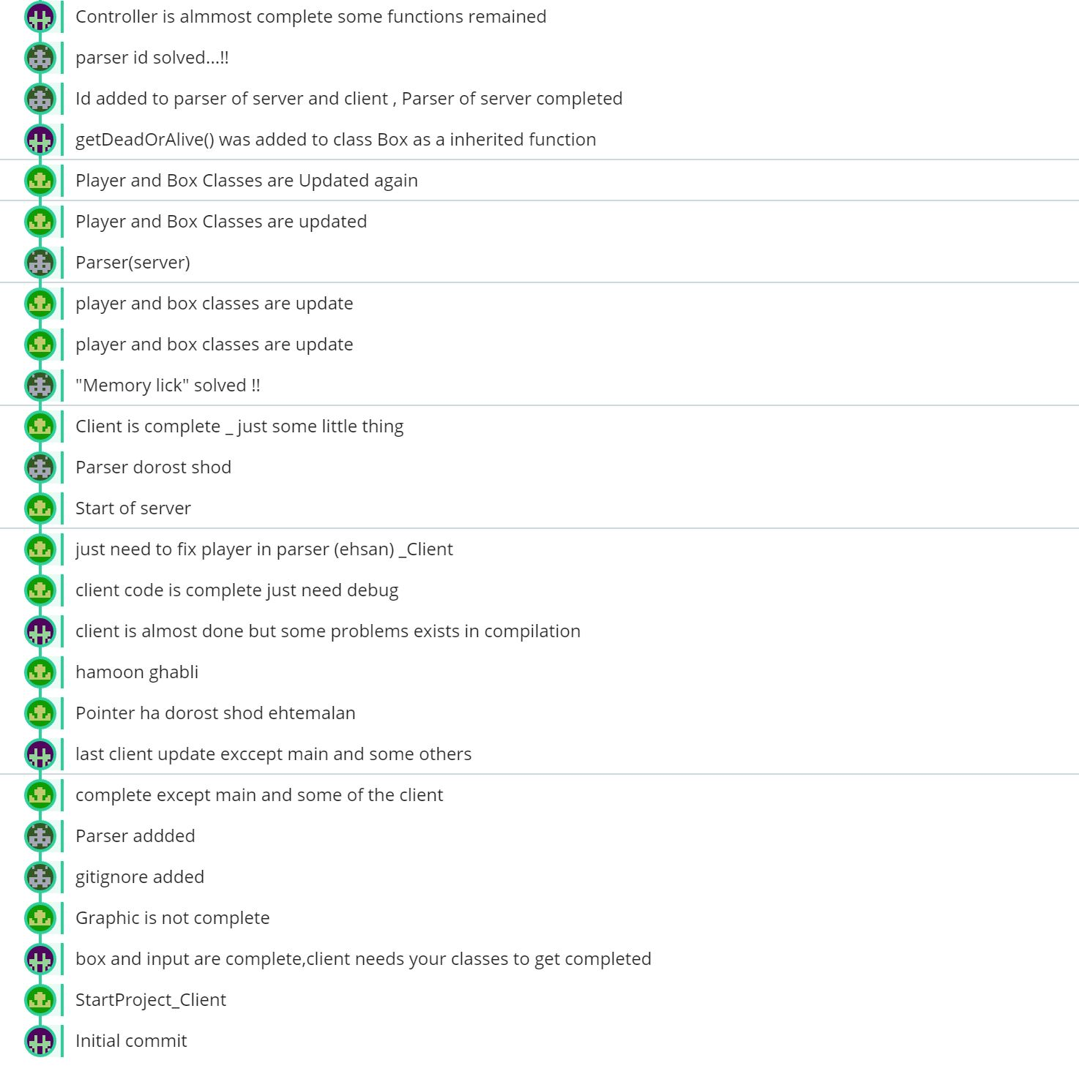
2
1

Slide 5
Client classes

Slide 6
client
graphic
player
Parser
connection
box
surface
player
input
Normal box
tnt box
gift box
input

Slide 7
server classes

Slide 8
controller
parser
box
input
box
input
player
Normal box
tnt box
gift box
Normal box
tnt box
gift box
input
player
connection
box
Normal box
tnt box
gift box

Slide 9
Headers file

Slide 10
client

Slide 11
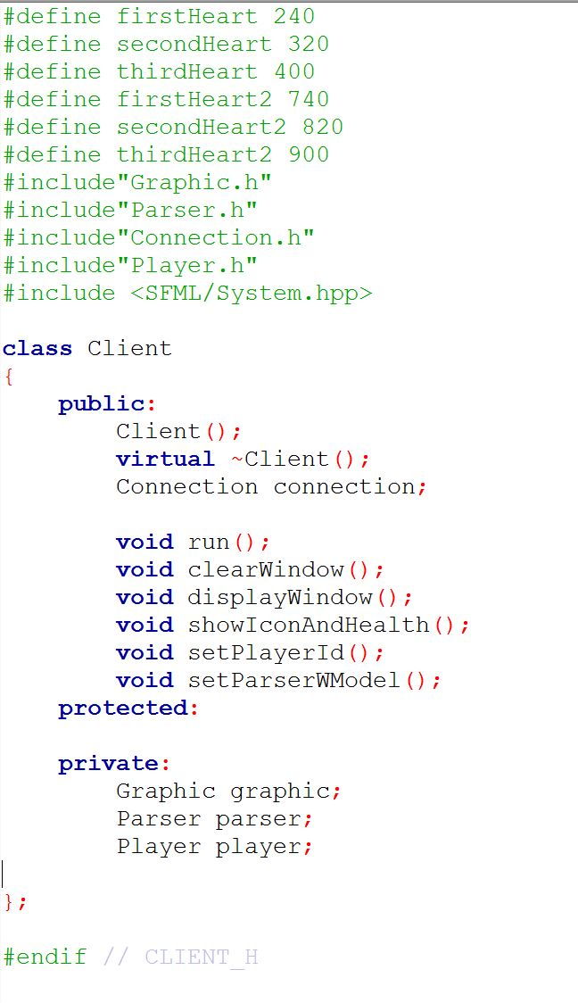
Client class

Slide 12
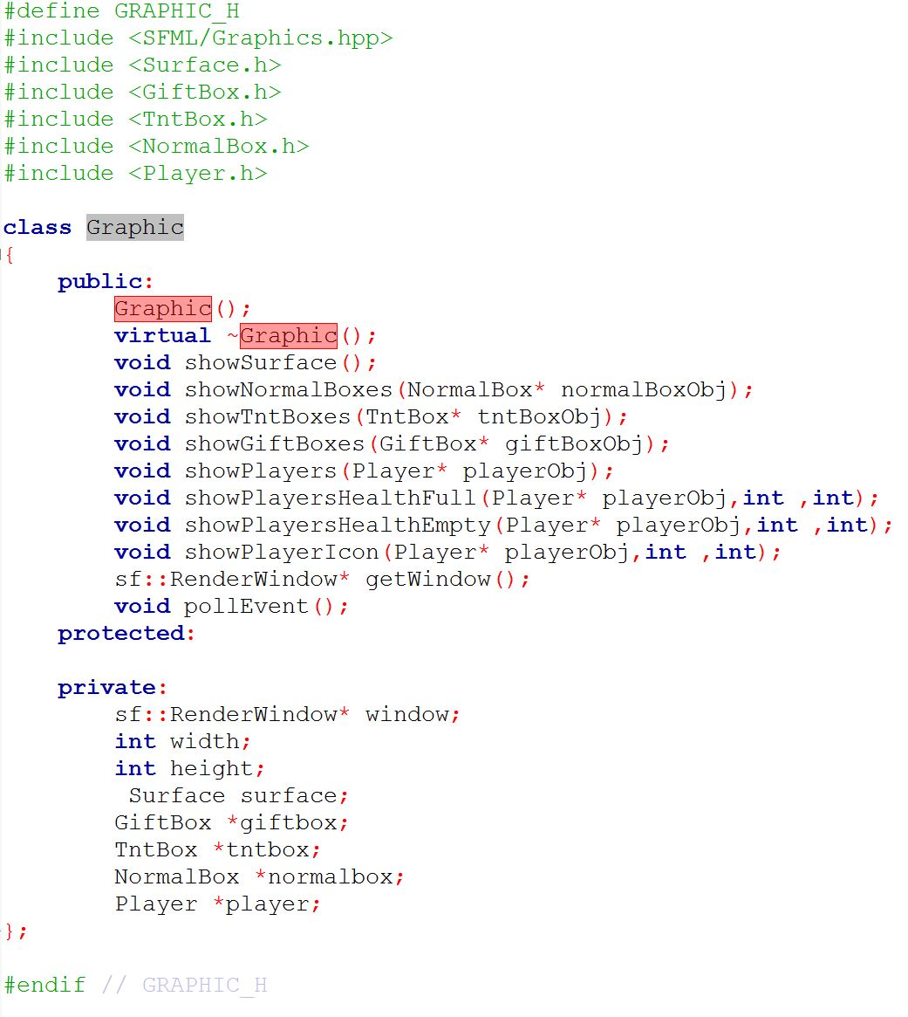
graphic

Slide 13
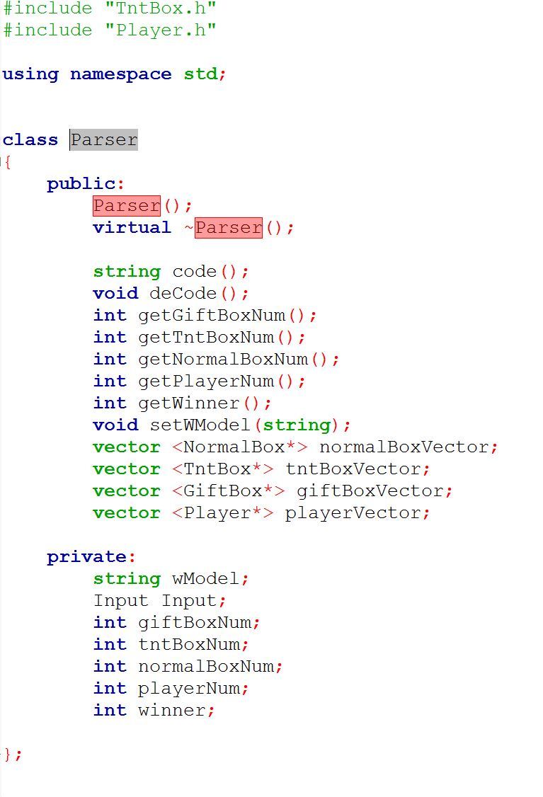
parser

Slide 14
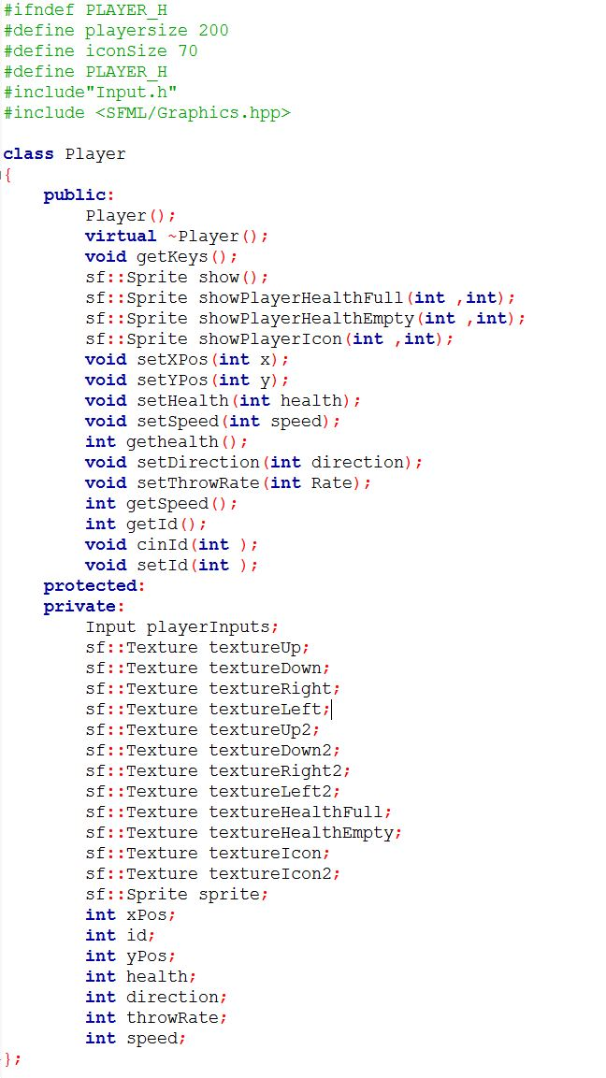
player

Slide 15
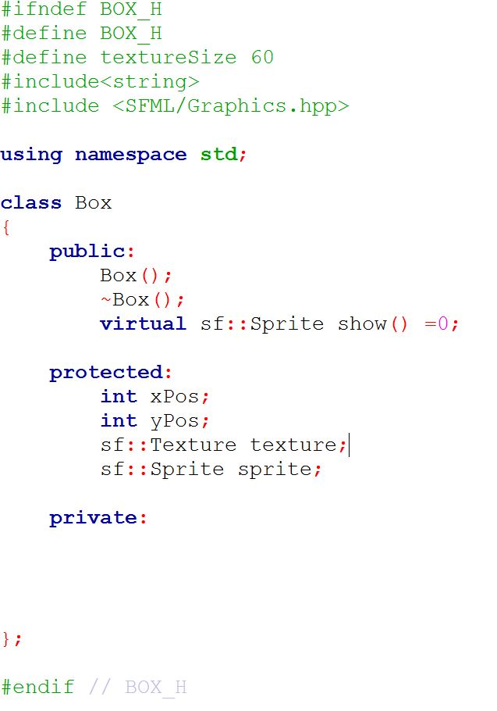
box

Slide 16
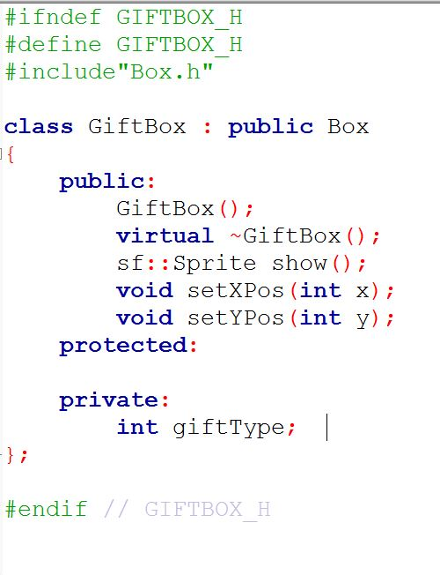
Giftbox

Slide 17
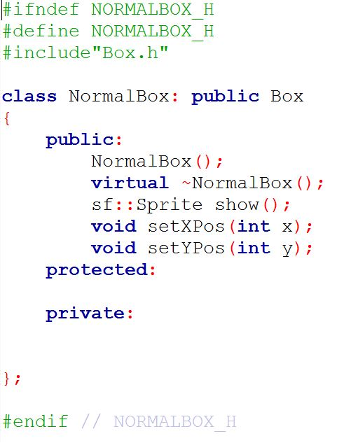
normalbox

Slide 18
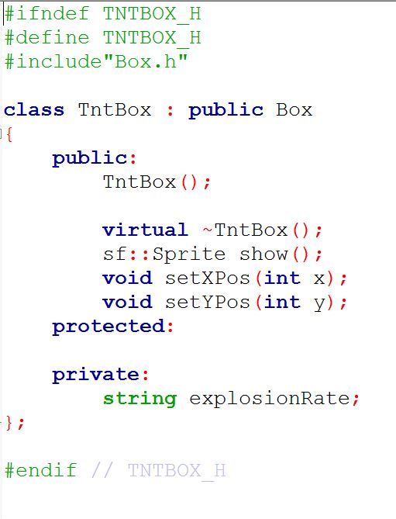
tntbox

Slide 19
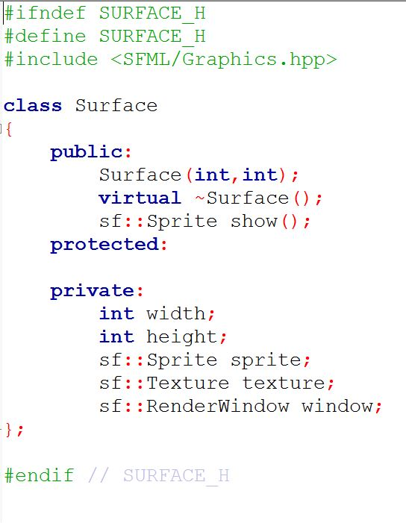
surface

Slide 20
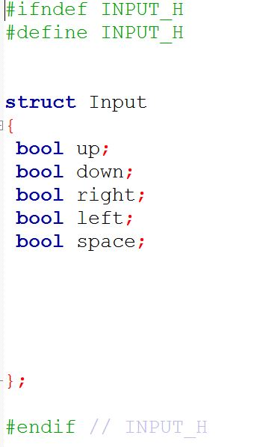
input

Slide 21
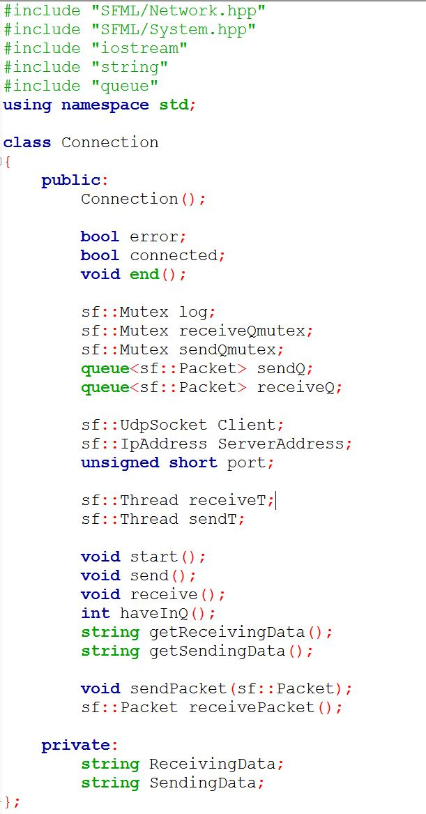
connection

Slide 22
server

Slide 23
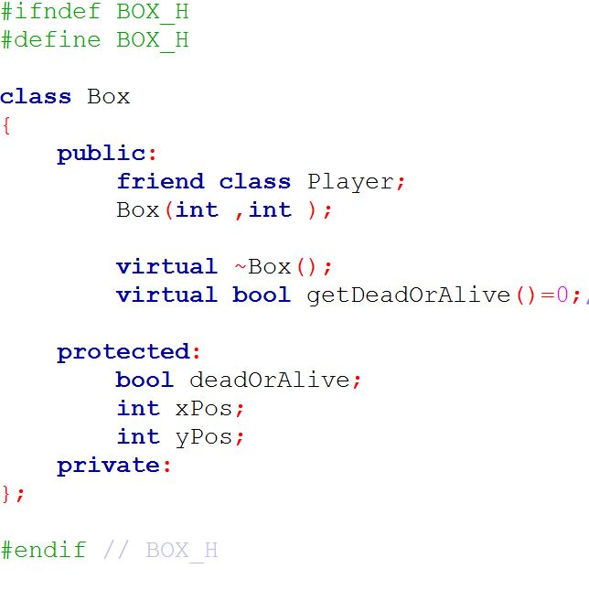
box

Slide 24
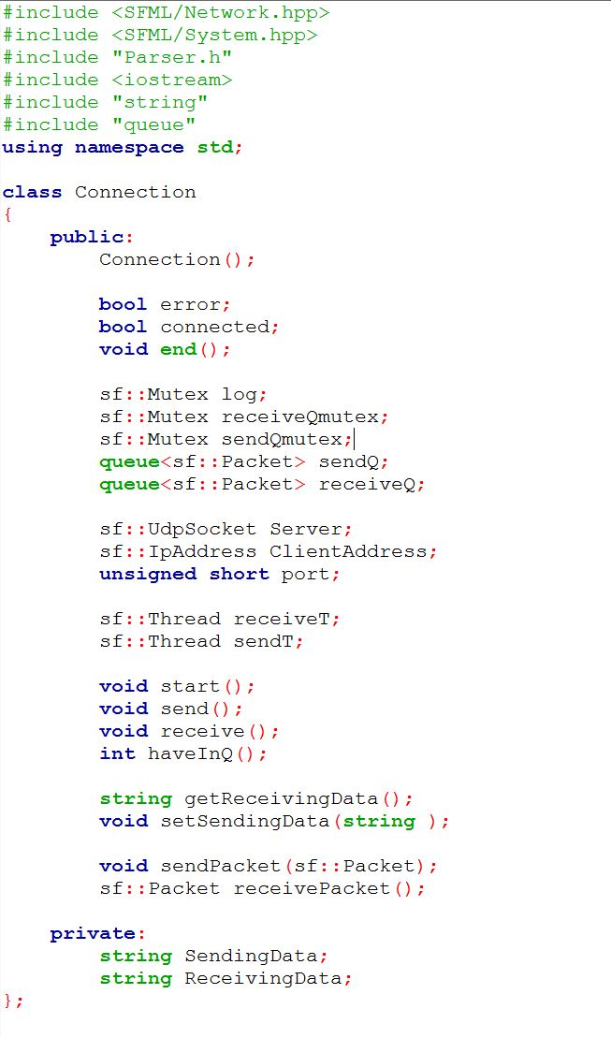
connection

Slide 25
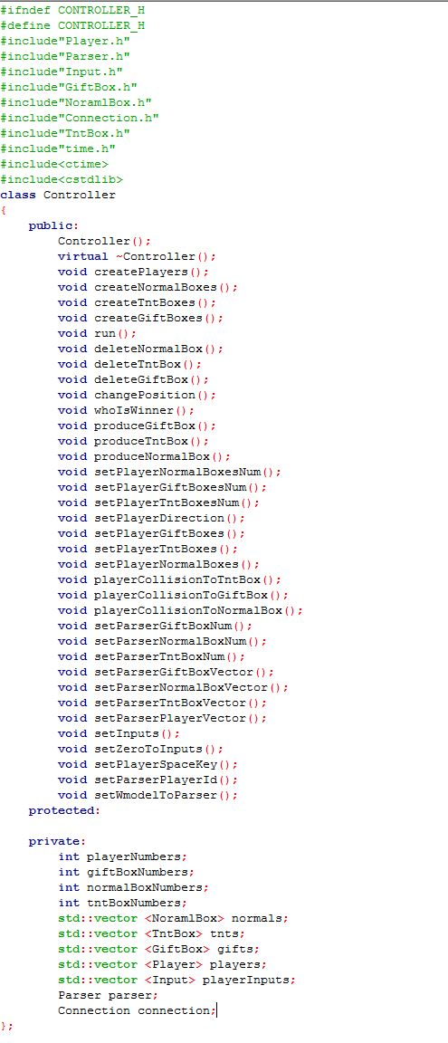
controller
1
2

Slide 26
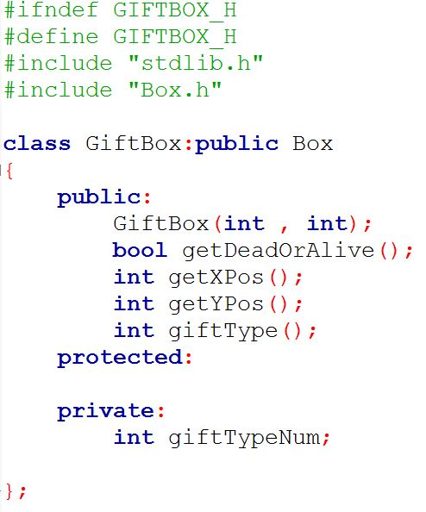
giftbox

Slide 27
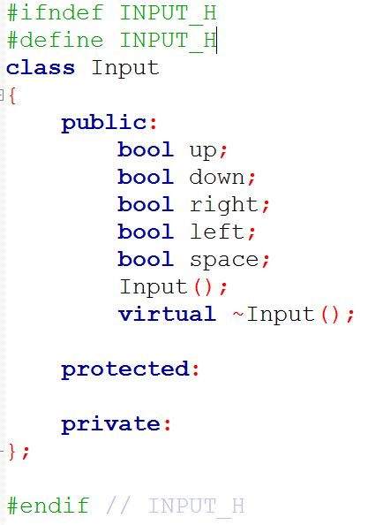
input

Slide 28
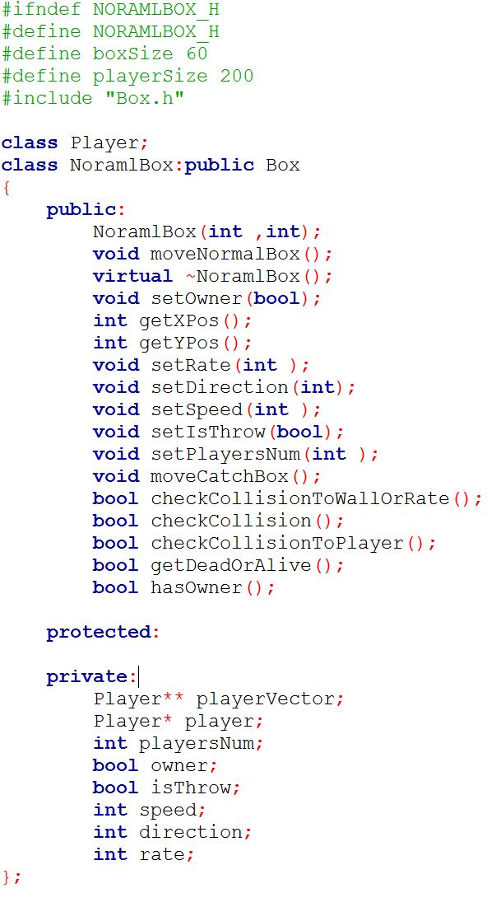
player

Slide 29
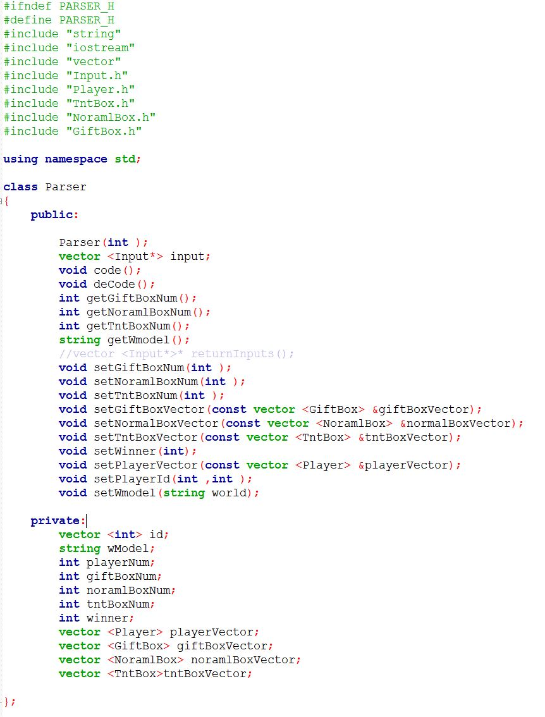
parser

Slide 30
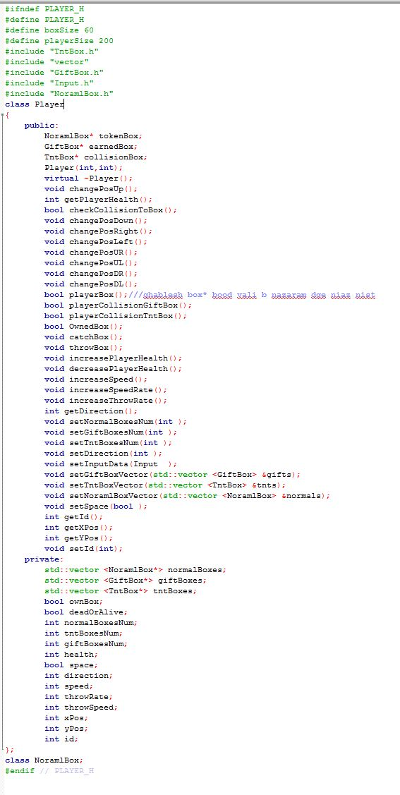
player
1
2

Slide 31
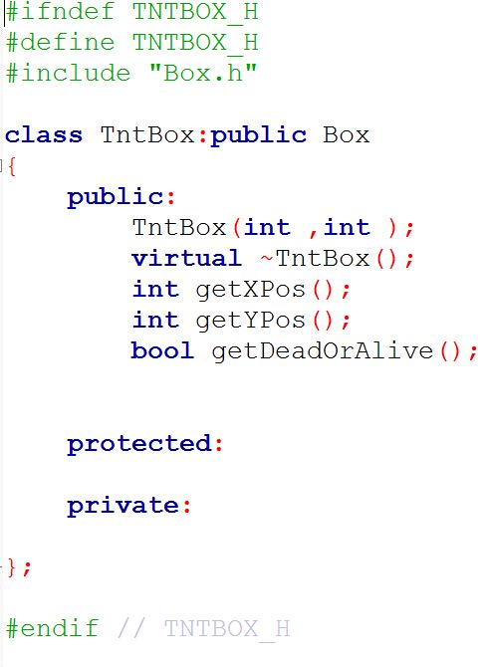
tntbox

